Slide 1
UMMC Occupational Therapy Department Virtual Simulation- Module 3
Occupational Therapy with Adults
4 hours
After reviewing this module, please complete the corresponding section in the
Virtual Observation Reflection packet.

Slide 2
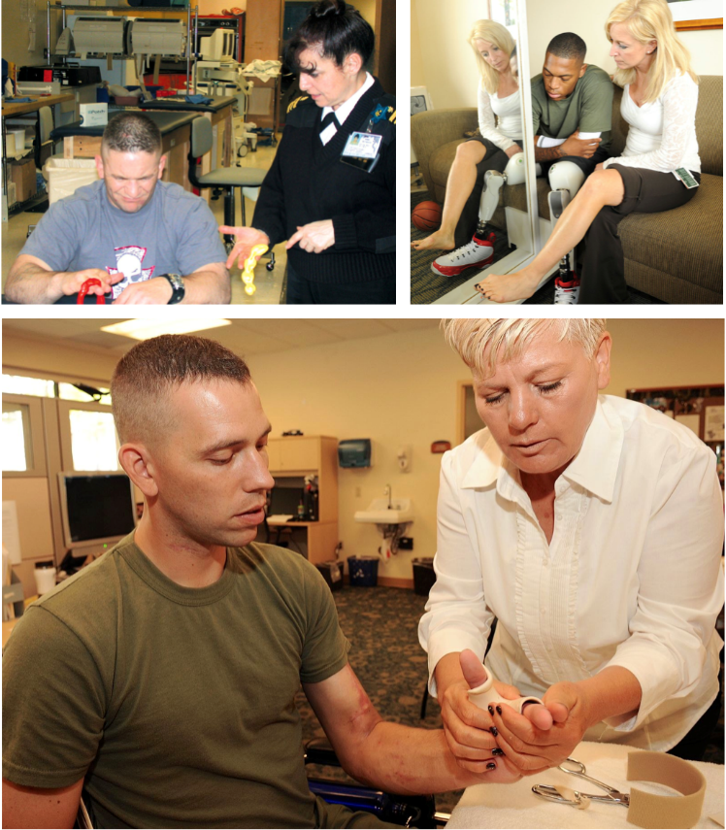
Review Fact Sheets
Watch: Falls Prevention for Elderly Video
Read: Clients with Stroke
Read: OT and Hand Rehabilitation

Slide 3
Spinal Cord Injury
1.Watch The Upside, available to stream online
2. Read Fact Sheet: Seating and Wheeled Mobility
3. Complete Assignment: Write a 2-page reflection about The Upside. Include a brief summary of the characters and a discussion of the relationship between the two men. How was the relationship helpful? How was it hurtful? How was it beneficial to both?

Slide 4
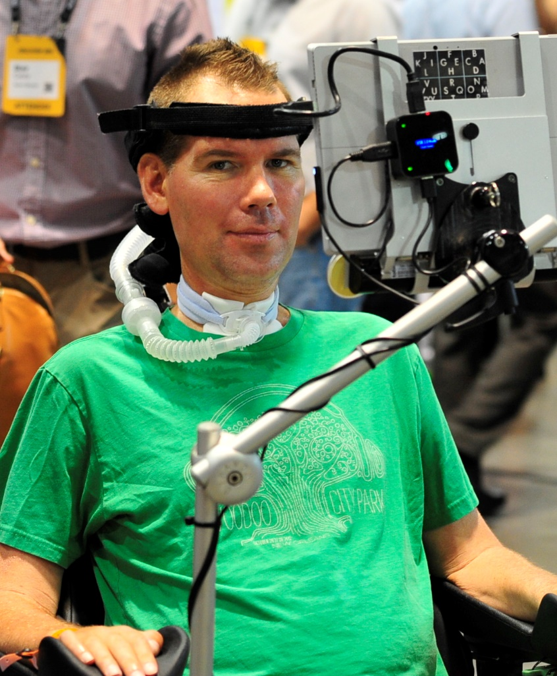
Amyotrophic Lateral Sclerosis (ALS): A Case Study
Watch “Mr. Connelly has ALS” https://vimeo.com/230606513 .
Answer the following questions:
1.What is ALS (amyotrophic lateral sclerosis)? What is it caused by? What age group does it effect?
2.What daily activities were affected? (Circle all that apply)
Speech
Movement
Driving
Work
Socializing
3.How did the disease process effect the family?
4.Name two ways that Mr. Connelly was able to communicate with others.
5.How did Mr. Connelly make you feel?

Slide 5
References
American Occupational Therapy Association (2013). Recovering from stroke [Fact sheet]. Retrieved from: https://www.aota.org/~/media/Corporate/Files/AboutOT/consumers/Adults/Stroke/Stroke%20Tip%20Sheet
Amini, D. (2016). Occupational therapy’s role with rehabilitation of the hand [Fact sheet]. American Occupational Therapy Association. Retrieved from: https://www.aota.org/-/media/Corporate/Files/AboutOT/Professionals/WhatIsOT/RDP/Facts/Hand%20Therapy%20fact%20sheet.pdf
Burger, N. (Director). (2017). The upside [Film]. Escape Artists.
Habib, D. (Director). (2017). Mr. Connelly has ALS. Institute on Disability University of New Hampshire.
Trudeau, S. (N.D.). How to Prevent Falls in the Home: Tips from AOTA and the National Council on Aging [video]. American Occupational Therapy Association.

